Slide 1



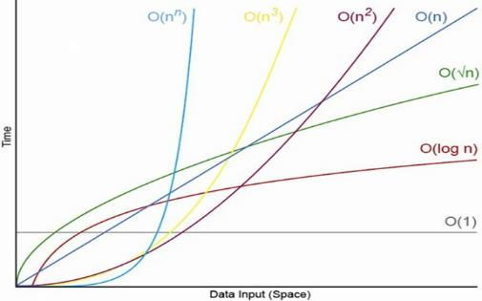
Data Structures, Algorithms and Complexity
O(n)
Analyzing Algorithm Complexity. Asymptotic Notation
Data
Structures
SoftUni Team
Technical Trainers
Software University
http://softuni.bg

Slide 2

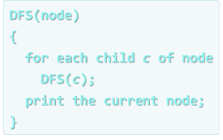
Algorithm Complexity
Asymptotic Notation

Slide 3



Algorithm Analysis
Why should we analyze algorithms?
Predict the resources the algorithm will need
Computational time (CPU consumption)
Memory space (RAM consumption)
Communication bandwidth consumption
The expected running time of an algorithm is:
The total number of primitive operations executed (machine independent steps)
Also known as algorithm complexity

Slide 4
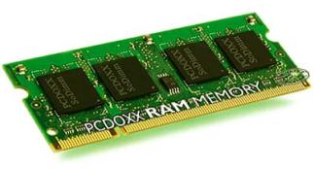
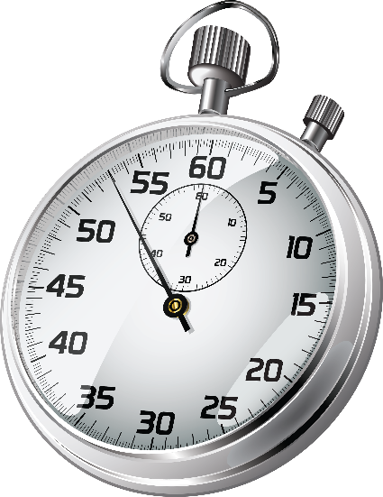
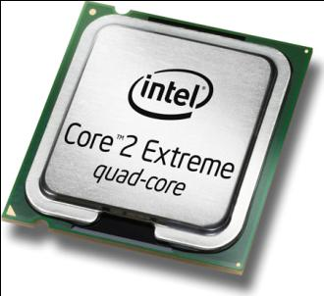

Algorithmic Complexity
What to measure?
CPU time
Memory consumption
Number of steps
Number of particular operations
Number of disk operations
Number of network packets
Asymptotic complexity

Slide 5
Time Complexity
Worst-case
An upper bound on the running time for any input of given size
Typically algorithms performance is measured for their worst case
Average-case
The running time averaged over all possible inputs
Used to measure algorithms that are repeated many times
Best-case
The lower bound on the running time (the optimal case)

Slide 6

Time Complexity: Example
Sequential search in a list of size n
Worst-case:
n comparisons
Best-case:
1 comparison
Average-case:
n/2 comparisons
The algorithm runs in linear time
Linear number of operations
… | … | … | … | … | … | …
n

Slide 7
Algorithms Complexity
Algorithm complexity is a rough estimation of the number of steps performed by given computation, depending on the size of the input
Measured with asymptotic notation
O(g) where g is a function of the size of the input data
Examples:
Linear complexity O(n)
All elements are processed once (or constant number of times)
Quadratic complexity O(n²)
Each of the elements is processed n times

Slide 8
Asymptotic Notation: Definition
Asymptotic upper bound
O-notation (Big O notation)
For a given function g(n), we denote by O(g(n)) the set of functions that are different than g(n) by a constant
Examples:
3 * n² + n/2 + 12 ∈ O(n²)
4*n*log₂(3*n+1) + 2*n-1 ∈ O(n * log n)
O(g(n)) = {f(n): there exist positive constants c and n₀ such that f(n) <= c*g(n) for all n >= n₀}

Slide 9
Functions Growth Rate
ƒ(n)
О(n) means a function grows linearly when n increases
E.g.
O(n²) means a function grows quadratically when n increases
E.g.
O(1) means a function does not grow when n changes
E.g.
18
17
16
15
14
13
12
11
10
9
8
7
6
5
4
3
2
1
0
ƒ(n)=n+1
ƒ(n)=n²+2n+2
ƒ(n)=4
0 1 2 3 4 5 6 7 8 9 10 11 12 13 14 15
n

Slide 10
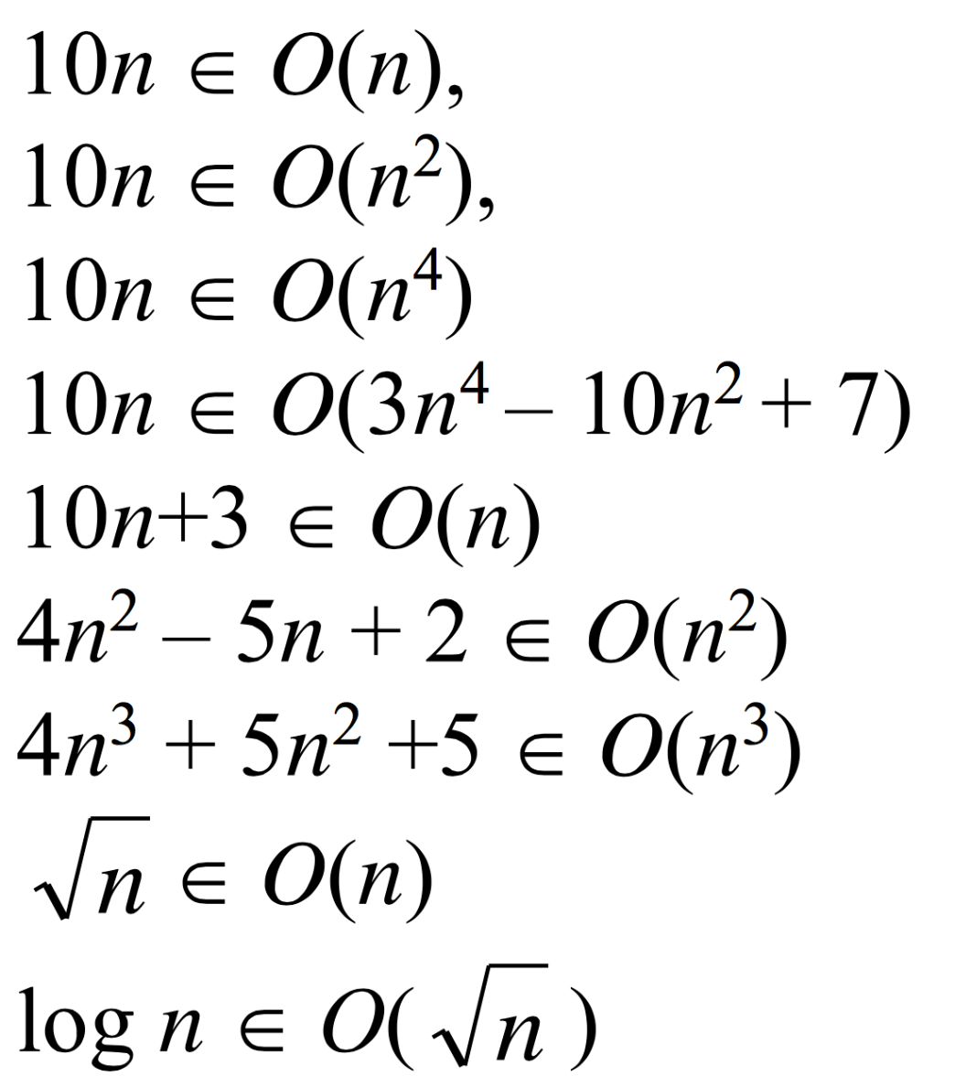
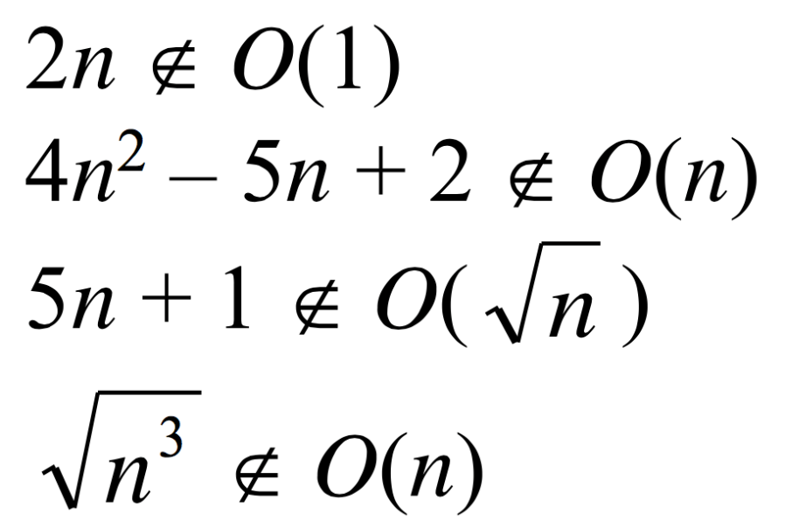
Examples
Positive examples:
Negative examples:

Slide 11
Asymptotic Functions

Slide 12
Typical Complexities
Complexity | Notation | Description
constant | O(1) | Constant number of operations, not depending on the input data size, e.g. n = 1 000 000 → 1-2 operations
logarithmic | O(log n) | Number of operations proportional to log₂(n) where n is the size of the input data, e.g. n = 1 000 000 000 → 30 operations
linear | O(n) | Number of operations proportional to the input data size, e.g. n = 10 000 → 5 000 operations

Slide 13
Typical Complexities (2)
Complexity | Notation | Description
quadratic | O(n²) | Number of operations proportional to the square of the size of the input data, e.g. n = 500 → 250 000 operations
cubic | O(n³) | Number of operations propor-tional to the cube of the size of the input data, e.g. n = 200 → 8 000 000 operations
exponential | O(2^{n}), O(k^{n}), O(n!) | Exponential number of operations, fast growing, e.g. n = 20 → 1 048 576 operations

Slide 14
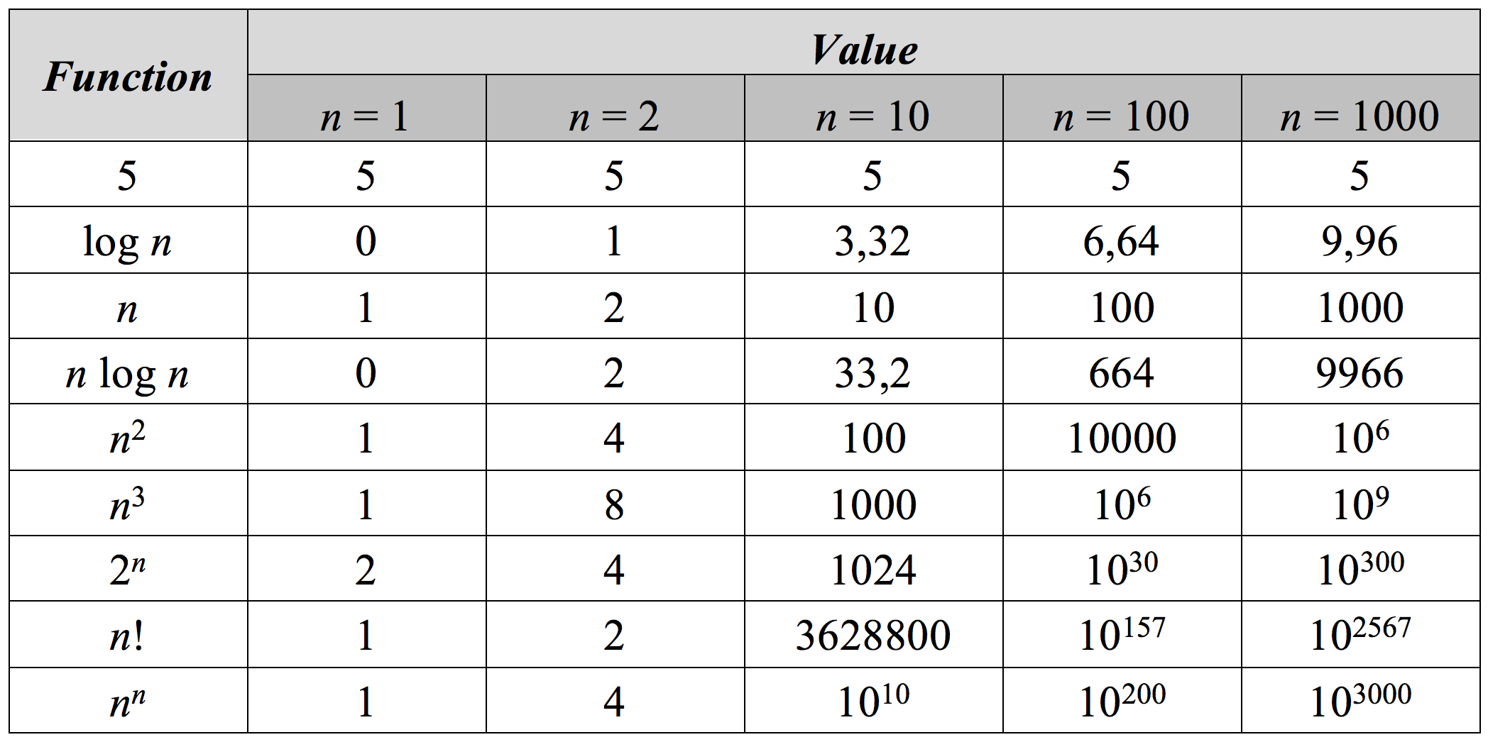
Function Values

Slide 15
Time Complexity and Program Speed
Complexity | 10 | 20 | 50 | 100 | 1 000 | 10 000 | 100 000
O(1) | < 1 s | < 1 s | < 1 s | < 1 s | < 1 s | < 1 s | < 1 s
O(log(n)) | < 1 s | < 1 s | < 1 s | < 1 s | < 1 s | < 1 s | < 1 s
O(n) | < 1 s | < 1 s | < 1 s | < 1 s | < 1 s | < 1 s | < 1 s
O(n*log(n)) | < 1 s | < 1 s | < 1 s | < 1 s | < 1 s | < 1 s | < 1 s
O(n²) | < 1 s | < 1 s | < 1 s | < 1 s | < 1 s | 2 s | 3-4 min
O(n³) | < 1 s | < 1 s | < 1 s | < 1 s | 20 s | 5 hours | 231 days
O(2^{n}) | < 1 s | < 1 s | 260 days | hangs | hangs | hangs | hangs
O(n!) | < 1 s | hangs | hangs | hangs | hangs | hangs | hangs
O(n^{n}) | 3-4 min | hangs | hangs | hangs | hangs | hangs | hangs

Slide 16
Time and Memory Complexity
Complexity can be expressed as a formula of multiple variables, e.g.
Algorithm filling a matrix of size n * m with the natural numbers 1, 2, … n*m will run in O(n*m)
Algorithms to traverse a graph with n vertices and m edges will take O(n + m) steps
Memory consumption should also be considered, for example:
Running time O(n) & memory requirement O(n²)
n = 50 000 → OutOfMemoryException
Is it possible in practice? In theory?

Slide 17
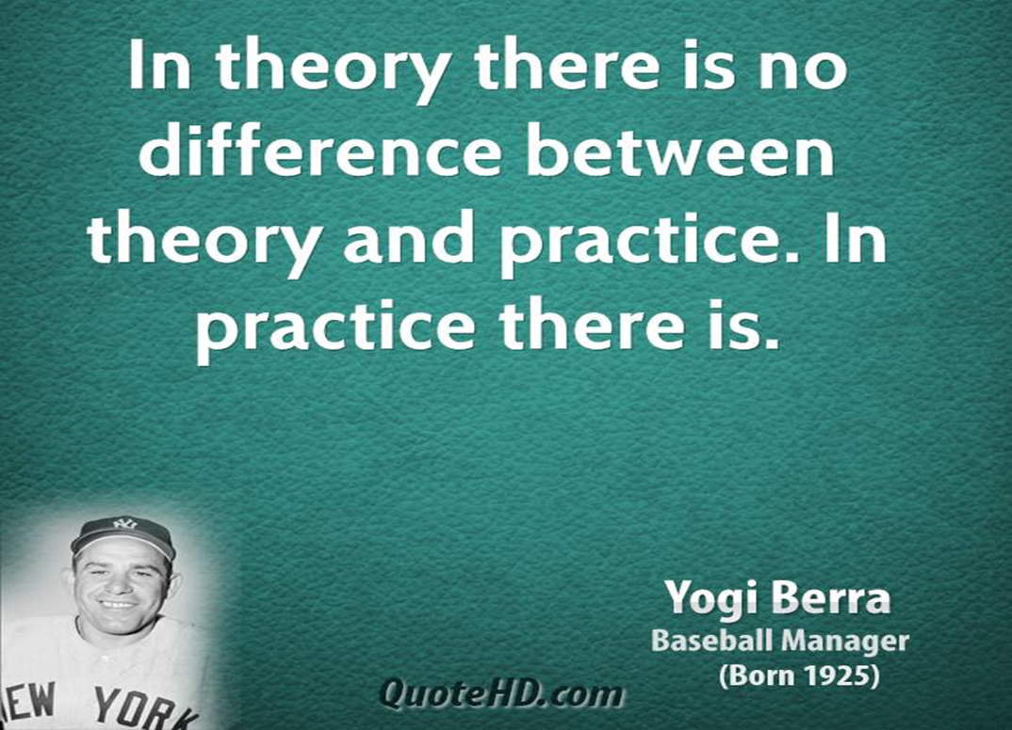
Theory vs. Practice

Slide 18
The Hidden Constant
A linear algorithm could be slower than a quadratic algorithm
The hidden constant could be significant
Example:
Algorithm A performs 100*n steps → O(n)
Algorithm B performs n*(n-1)/2 steps → O(n²)
For n < 200, algorithm B is faster
Real-world example:
The "insertion sort" is faster than "quicksort" for n < 9

Slide 19
Amortized Analysis
void AddOne(char[] chars, int m)
{
for (int i = 0; 1 != chars[i] && i < m; i++)
{
c[i] = 1 - c[i];
}
}
Worst case: O(n²)
Average case: O(n) – Why?

Slide 20
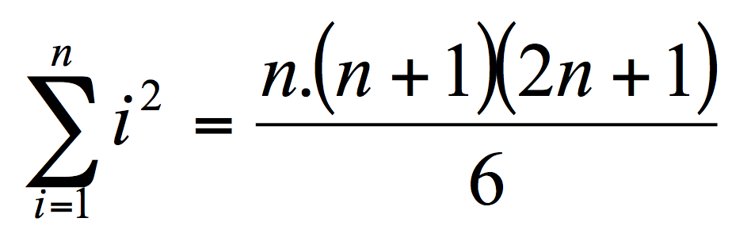
Using Math
sum = 0;
for (i = 1; i <= n; i++)
{
for (j = 1; j <= i*i; j++)
{
sum++;
}
}
Complexity: O(n³)

Slide 21
Using a Barometer
uint sum = 0;
for (i = 0; i < n; i++)
{
for (j = 0; j < i*i; j++)
{
sum++;
}
}
Console.WriteLine(sum);
Just calculate and print sum = n * (n + 1) * (2n + 1) / 6

Slide 22
Polynomial Algorithms
A polynomial-time algorithm has worst-case time complexity bounded above by a polynomial function of its input size
Examples:
Polynomial time: 2n, 3n³ + 4n
Exponential time: 2^{n}, 3^{n}, n^{k}, n!
Exponential algorithms hang for large input data sets
W(n) ∈ O(p(n))

Slide 23
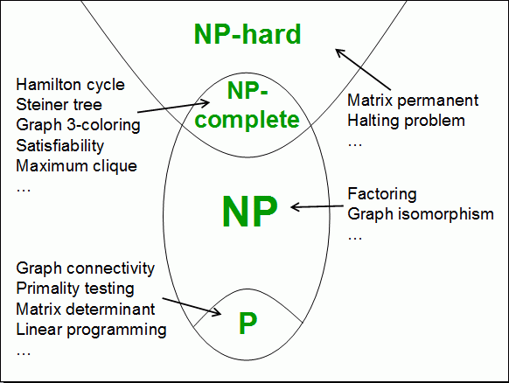
Computational Classes
Computational complexity theory divides the computational problems into several classes:

Slide 24
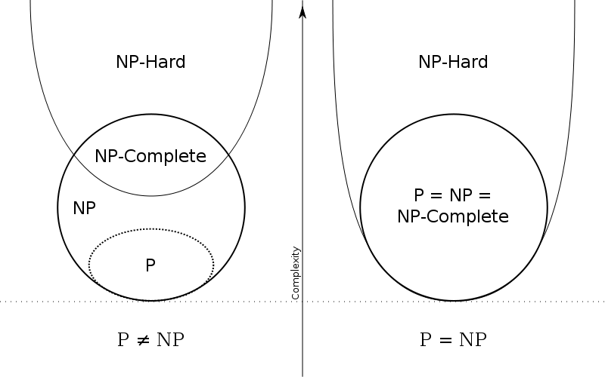
P vs. NP: Problem #1 in Computer Science Today

Slide 25

Analyzing the Complexity of Algorithms
O(n)
O(n+m)
O(n²)
O(n!)
O(n*m)
Examples

Slide 26
Complexity Examples
int FindMaxElement(int[] array)
{
int max = array[0];
for (int i = 1; i < array.length; i++)
{
if (array[i] > max)
{
max = array[i];
}
}
return max;
}
Runs in O(n) where n is the size of the array
The number of elementary steps is ~ n

Slide 27
Complexity Examples (2)
long FindInversions(int[] array)
{
long inversions = 0;
for (int i = 0; i < array.Length; i++)
for (int j = i + 1; j < array.Length; i++)
if (array[i] > array[j])
inversions++;
return inversions;
}
Runs in O(n²) where n is the size of the array
The number of elementary steps is ~ n * (n+1) / 2

Slide 28
Complexity Examples (3)
decimal Sum3(int n)
{
decimal sum = 0;
for (int a = 0; a < n; a++)
for (int b = 0; b < n; b++)
for (int c = 0; c < n; c++)
sum += a * b * c;
return sum;
}
Runs in cubic time O(n³)
The number of elementary steps is ~ n³

Slide 29
Complexity Examples (4)
long SumMN(int n, int m)
{
long sum = 0;
for (int x = 0; x < n; x++)
for (int y = 0; y < m; y++)
sum += x * y;
return sum;
}
Runs in quadratic time O(n*m)
The number of elementary steps is ~ n*m

Slide 30
Complexity Examples (5)
long SumMN(int n, int m)
{
long sum = 0;
for (int x = 0; x < n; x++)
for (int y = 0; y < m; y++)
if (x == y)
for (int i = 0; i < n; i++)
sum += i * x * y;
return sum;
}
Runs in quadratic time O(n*m)
The number of elementary steps is ~ n*m + min(m,n)*n

Slide 31
Complexity Examples (6)
decimal Calculation(int n)
{
decimal result = 0;
for (int i = 0; i < (1<<n); i++)
result += i;
return result;
}
Runs in exponential time O(2^{n})
The number of elementary steps is ~ 2^{n}

Slide 32
Complexity Examples (7)
decimal Factorial(int n)
{
if (n == 0)
return 1;
else
return n * Factorial(n - 1);
}
Runs in linear time O(n)
The number of elementary steps is ~ n

Slide 33
Complexity Examples (8)
decimal Fibonacci(int n)
{
if (n == 0)
return 1;
else if (n == 1)
return 1;
else
return Fibonacci(n-1) + Fibonacci(n-2);
}
Runs in exponential time O(2^{n})
The number of elementary steps is ~ Fib(n+1) where Fib(k) is the k^{th} Fibonacci's number

Slide 34
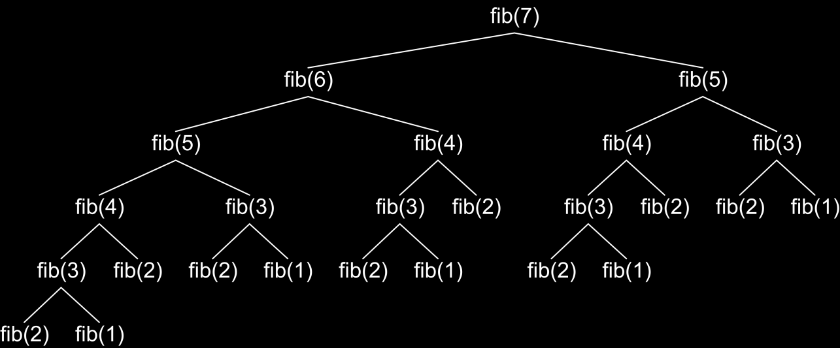
Fibonacci Recursion Tree
fib(n) makes about fib(n) recursive calls
The same value is calculated many, many times!

Slide 35
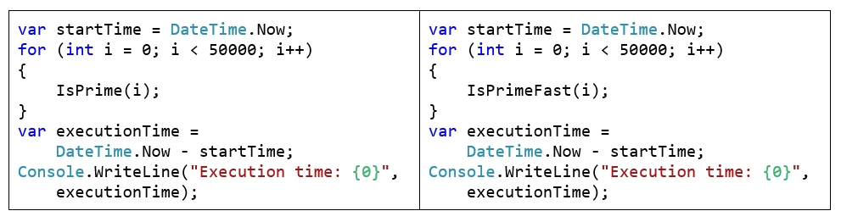
Lab Exercise
Calculating Complexity of Existing Code

Slide 36
Summary
Data structures organize data in computer systems for efficient use
Abstract data types (ADT) describe a set of operations
Collections hold a group of elements
Algorithms are sequences of steps for calculating / doing something
Algorithm complexity is a rough estimation of the number of steps performed by given computation
Can be logarithmic, linear, n log n, square, cubic, exponential, etc.
Complexity predicts the speed of given code before its execution

Slide 37








Data Structures, Algorithms and Complexity
https://softuni.bg/trainings/1308/data-structures-february-2016

Slide 38
License
This course (slides, examples, labs, videos, homework, etc.) is licensed under the "Creative Commons Attribution-NonCommercial-ShareAlike 4.0 International" license
Attribution: this work may contain portions from
"Fundamentals of Computer Programming with C#" book by Svetlin Nakov & Co. under CC-BY-SA license
"Data Structures and Algorithms" course by Telerik Academy under CC-BY-NC-SA license

Slide 39






Free Trainings @ Software University
Software University Foundation – softuni.org
Software University – High-Quality Education, Profession and Job for Software Developers
softuni.bg
Software University @ Facebook
facebook.com/SoftwareUniversity
Software University @ YouTube
youtube.com/SoftwareUniversity
Software University Forums – forum.softuni.bg

